Slide 1
3rd Annual Sarcoma Exchange Nutrition
Diana Torres, MPH, RD, CSO
Clinical Dietitian
Cedars-Sinai Cancer

Slide 2
Overview
Healthful Eating and Cancer Myths
Symptom Management
Weight Management after Treatment
Notes:
Cancer Myths to be discussed within General, Healthful eating slides

Slide 3
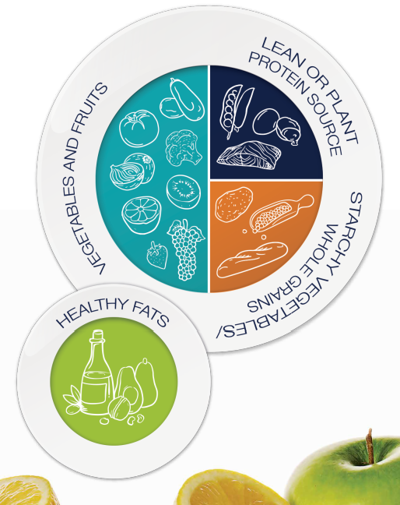
Plant-Based Diet
A dietary pattern centered on whole, unrefined or minimally refined plants
The majority of the diet is whole grains, legumes, fruit, and vegetables. The diet minimizes the consumption of refined grains and added sugar
Protein needs can be met through legumes, whole grains, dairy, eggs, fish, poultry, and lean meat
75% plant, 25% animal
Notes:
Discuss Cancer Myth – Fad Diets

Slide 4
Eyeball Serving Sizes

Slide 5
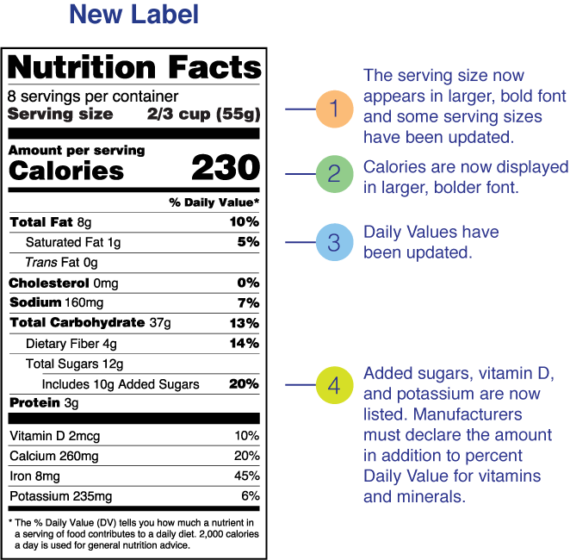
Look at Labels
Notes:
Serving sizes have been updated to reflect the amount people typically eat and drink today.
5% DV or less of a nutrient per serving is considered low.
20% DV or more of a nutrient per serving is considered high.
More often, choose foods that are:
Higher in dietary fiber, vitamin D, calcium, iron, and potassium.
Lower in saturated fat, sodium, and added sugars.

Slide 6
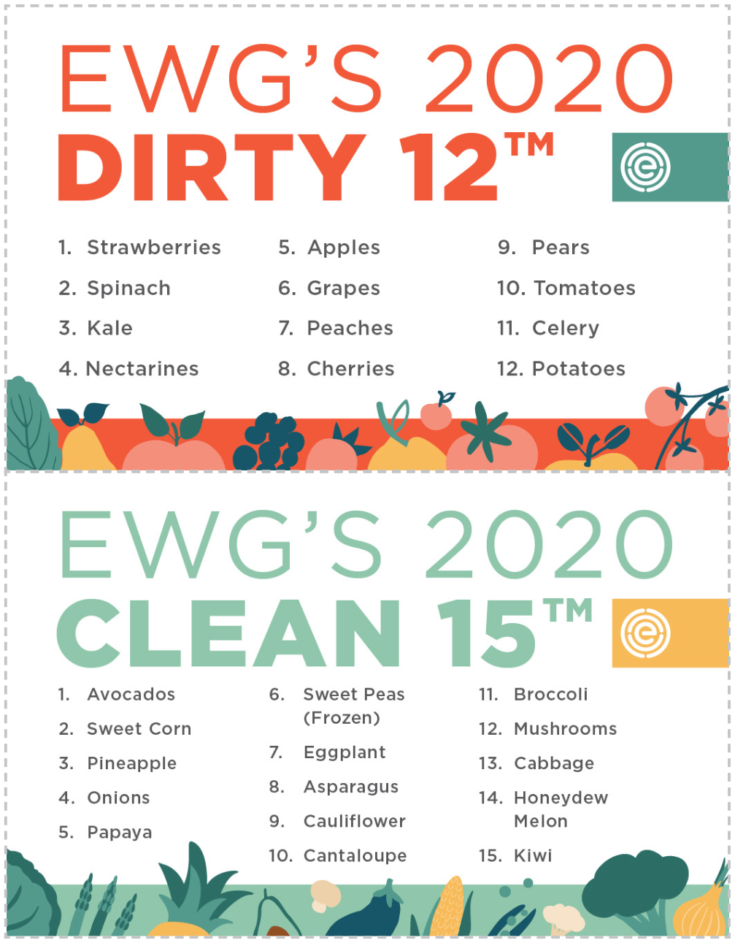
Eat Plenty of Vegetables and Fruits
5 portions each of vegetables and fruit daily
Colorful
Preparation
Raw, Steamed, Baked, Grilled, Juiced
Notes:
Discuss Cancer Myth – organic, no fruit

Slide 7
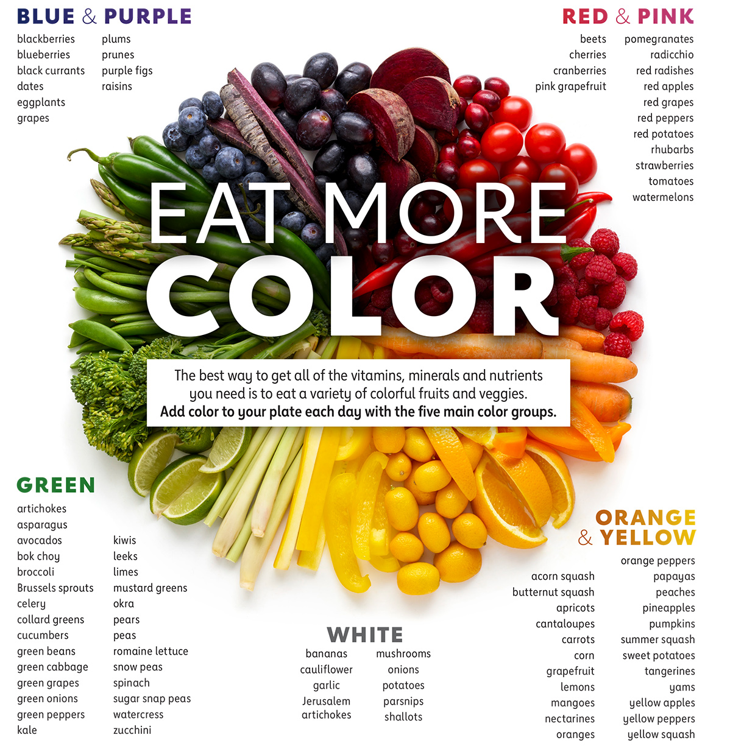
Notes:
½ cup
1 medium
1 cup – leafy
Discuss Cancer Myth – no white foods

Slide 8
Protein Needs
At least 0.8 gm Protein/kg Body Weight
Beef, Pork, and all Game Meat - 18 cooked oz/week
Limit or Avoid Processed Meats
Cold Water Fish – at least 8 cooked oz/week
Plant Protein Sources – Legumes, Nuts, Seeds, Whole Grains, Vegetables
Notes:
Muscle is harder to build and maintain as we age. Most people start losing muscle around age 30 with 3-8% reduction in muscle mass every decade after.
Resistance training 2-3 times per week–Weightlifting, Pilates, yoga
•Fuel up with protein and carbohydrates 1-3 hours before exercising
•Replenish with protein during and up to 2 hours after activity
•Aim for 15-25g protein (0.25-0.3g/kg body weight) American College of Sports Medicine
Red meat is a source of: Polycyclic aromatic hydrocarbons, Polycyclic amines, Nitrates/Nitrites – N-nitroso compounds
Fish may be a source of mercury.
Plant proteins may be incomplete proteins.

Slide 9
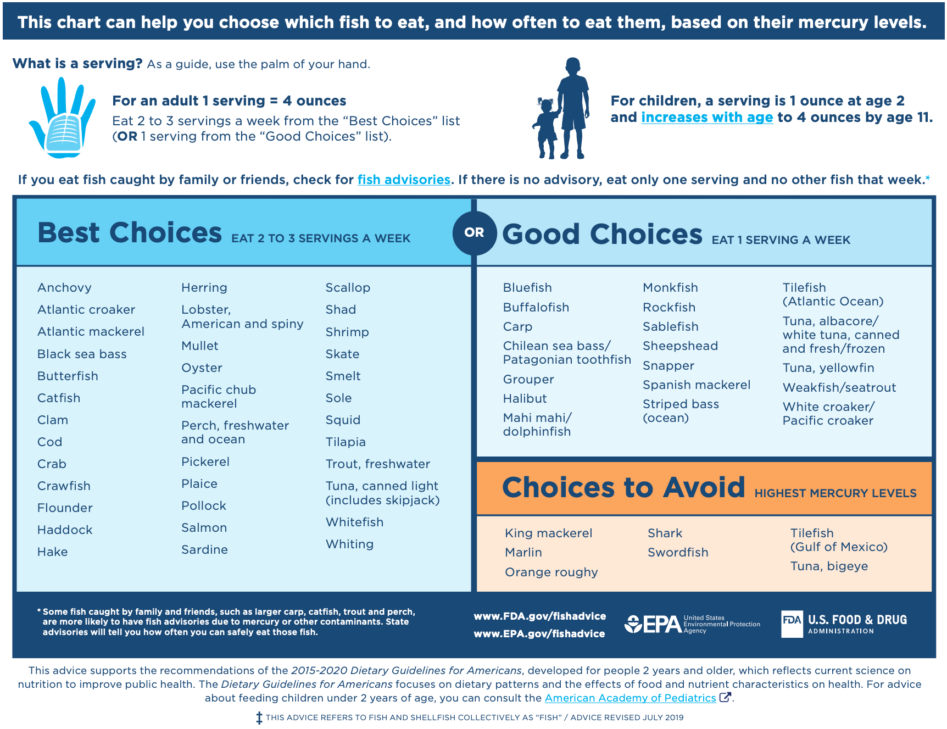
Mercury in Fish
Notes:
At least 8 ounces of seafood (less for young children) per week based on a 2,000 calorie diet DHA EPA B12 D Zinc Selenium Iodine
https://fishadvisoryonline.epa.gov/Contacts.aspx
Omega 3s
Best – salmon, sardines, mussels, rainbow trout, atlantic mackerel
Good – oysters, pollock, herring
seafoodwatch.org
Discuss - Wild vs farm raised

Slide 10
Plant Protein
Notes:
9 essential amino acids: histidine, isoleucine, leucine, lysine, methionine, phenylalanine, threonine, tryptophan, and valine
Plant-based complete proteins: Quinoa, Soy, Buckwheat, Hemp, Chia seed, Spirulina, Tempeh, Amaranth also ezekiel bread (from sprouted whole grains and legumes, including barley, soybeans, wheat, lentils, millet, and spelt) and nutritional yeast (¼ cup (4TB) 60 kcal 8 grams Protein 3 gm fiber)
Legumes and vegetables lack methionine
Grains and seeds lack lysine
Plant protein combos: Whole grain pita bread and hummus, Peanut butter on whole grain toast, Spinach salad with nut and seed toppings, Steel-cut oatmeal with pumpkin seeds or peanut butter, Lentil soup with whole grain slice of bread
1 large potato = 283 kcal, 8 grams Protein, 8 grams Fiber, 64 grams CHO > may be too many CHO for Protein provided
½ cup black beans = 110 kcal, 8 grams Protein, 8 grams Fiber, 20 grams CHO plus iron, calcium, magnesium
½ c Lentils – 115 kcal, 9 gm Protein, 8 gm fiber
2 Tb Almond Butter – 200 kcal, 7 gm Protein, 3 gm Fiber
Typical portions of seeds – 1 TB (chia/hemp/flax)
Need to eat large amounts of vegetables to provide a significant amount of protein:
½ c broccoli – 15 kcal, 1 gm Pro
1 c kale – 9 kcal, <1 gm Pro
1 c asparagus – 9 spears, 27 kcal, 3 gm Protein
1 c brussel sprouts – 28 kcal, 3 gm Protein

Slide 11
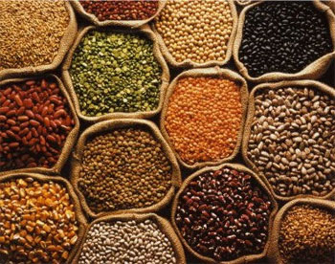
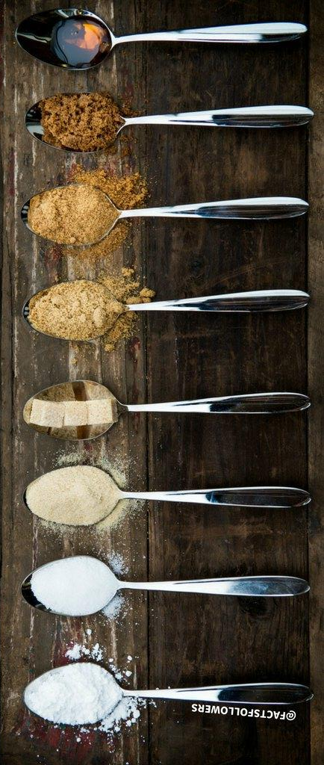
Choose Carbohydrates Wisely
Choose Complex Carbohydrates
Non-starchy Vegetables
Beans/Legumes, Fruits, Whole Grains
25 grams Fiber Daily
Limit Refined Carbohydrates
Sugars
Other Sweeteners
Pastries, Cakes, Desserts
<10% Total Calories from Added Sugars
Notes:
Fiber – avocado, artichoke, squash, split peas, beans, lentils, chia/flax/pumpkin seeds, raspberries, blueberries, apples, pears, pomegranates with the aerils
Discuss Cancer Myth – gluten, lectins, nightshades
Legumes (including beans, soybeans and peanuts) and grains contain the most lectins, followed by dairy, seafood and plants in the nightshade family.
The "stickiness" of lectins makes them prone to attaching to the intestinal wall.
There, they disrupt the body's routine maintenance of cells, so the everyday wear-and-tear that occurs in the intestine gradually worsens
The most extensively studied lectins are called phytohemagglutinins, which are mostly found in plants, especially legumes. Highest in raw kidney beans.
Repeated exposure to lectins may eventually damage the gut wall.
Unwanted substances can then more easily penetrate the gut, and may enter the bloodstream.
This condition of increased gut permeability is often called "leaky gut".
When lectins "leak" into the bloodstream, they can interact with glycoproteins on cell surfaces.
Lectins can also interact with antibodies, which are a core component of the immune system. This may cause an immune reaction not only against the lectins, but also the body tissues to which the lectins are bound.
This type of response is known as an autoimmune reaction, where the immune system mistakenly starts attacking the body's own structures. This is how lectins may increase the risk of autoimmune diseases.
While raw red kidney beans contain 20,000 to 70,000 hau (hemagglutinating unit), cooked kidney beans contain only 200-400 hau, a massive drop.
In one study, lectins in soybeans were mostly eliminated when the beans were boiled for only 5 to 10 minutes
Eliminate Lectin Content by: Cooking, Soaking, Sprouting, Fermenting
People with autoimmune or digestive problems may respond well to a diet that excludes most lectins, including those from dairy, eggs and plants of the nightshade family, like potatoes.
Discuss Cancer Myth – Sugar
Most Americans consume more than 355 calories of added sugar per day. 36% coming from soda, energy drinks and sports drinks. Other sources include ready to eat cereals and candy.
100 calories = 25 grams of sugar = 6 tsp of sugar
Possible effect of artificial sweeteners on the health of microbiome
Natural sweeteners in moderation is promoted

Slide 12
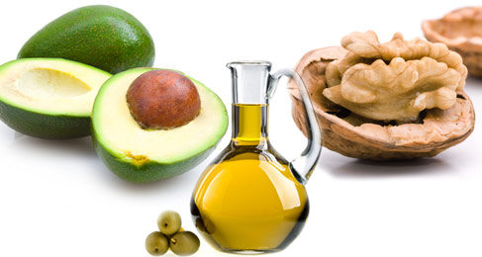
Focus on Healthy Fats
Unsaturated Fat Choose Often
Nuts, seeds, avocados, fatty fish, low omega-6 oils
Saturated Fat Limit
Red meat, whole milk, cheese, butter, pastries, ice cream, lard, palm oil, coconut oil
Trans Fat Avoid
Stick margarine and shortening, some processed foods, “partially hydrogenated oils”
Notes:
Consume less than 10% of calories from saturated fat (2000 kcal, 22 gm fat)
8 oz cold water fish weekly
Salmon, halibut, cod, mackerel, anchovies, sardines, krill
3 g/day GRAS
>3g ~ monitor for excessive bleeding
a-Linolenic fatty acid (ALA) is found in flaxseed, walnuts, chia, and algae
5-15% of ALA can convert to EPA
1% of ALA converts to DHA
High smokepoint – almond (nutty flavor), avocado (sweet aroma), refined olive oil (high in monounsaturated fat, lighter flavor), safflower (omega 6, oleic acid added - mufa), sunflower (pufa, oleic acid added)
Medium-High – canola, grapeseed, macadamia nut, extra virgin olive, peanut,
Coconut – medium – cold pressed more nutrients, more MCTs
Anti-inflammatory pathways – eicosanoid production, changes in cell membrane fluidity, cell signalling
Suppress NF-kappa B

Slide 13
Notes:
Average American consumption > 3500 mg.
Goal 2400 mg (1 tsp of salt) or tighter 1500 mg depending on your doctor's recommendations
Mostly comes from bread, condiments, canned/processed foods.

Slide 14
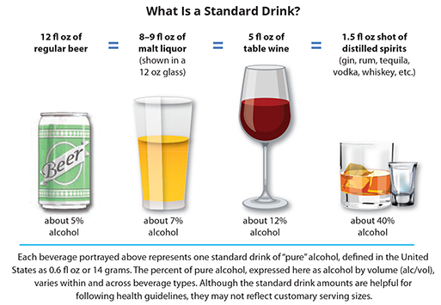
Select Beverages Carefully
Water is your best bet
Avoid Sweetened Beverages
Limit Fruit Juice
Limit Alcoholic Beverages
Women ≤ 1/day
Men ≤ 2/day
% is Key
Notes:
Alcohol’s effects vary depending on how much you drink, how often you drink, your age, your health status and your family history
Pay attention to alcohol percentages: IPA 5-9% alcohol Double IPA @ 14% = 2.8 drinks; typical margarita = 1.8 drinks; Cadillac Margarita = 2.7 drinks
Consequences – reduced inhibitions, slurred speech, motor impairment, confusion, memory problems, concentration problems, coma, breathing problems, death
Long-term effects – Wernicke-Korsakoff syndrome (Thiamine deficiency (B1)) brain disorder
https://www.rethinkingdrinking.niaaa.nih.gov/

Slide 15
Symptom Management -
Nausea
Encourage anti-emetic medication as prescribed
Dry, low-fat, non-odorous, and bland foods
Small frequent meals
Relaxed meal-time environment
Sip on caloric beverages
Hard candies
Peppermint or lemon drops
Candied ginger
Notes:
Acute
High – doxorubicin > 60 mg/m², cytoxan > 1500mg/m², cis, ifosfamide > 2g/m²
Med – Cytoxan <1500, doxorubicin <60, mtx > 250 mg/m²
delayed (cis, carbo, cytoxan, anthracycline, oxali)
Anticipatory (conditioned), Breakthrough (despite meds), Refractory (subsequent, unresponsive to tx)
The most common chemotherapy drugs used to treat soft tissue sarcoma include:
Ifosfamide (high), Doxorubicin(med/hi/acute/delayed), Cisplatin (hi/acute/delayed), Gemcitabine (lo), Vincristine, Docetaxel (lo), Methotrexate(med/lo), Paclitaxel (lo), Vinorelbine
Avoid foods that are spicy, fried or greasy
Avoid foods with strong odors
Choose foods that are cool or warm (not hot or cold)

Slide 16
Vomiting
Keep mouth clean
Solution of baking soda or salt and warm water
Drink clear liquids as tolerated
Dry, low-fat, bland foods
Drink ½ to 1 cup fluid per emesis episode

Slide 17
Poor Appetite
Small frequent nutrient-dense meals
Modify taste, texture and temperature of foods
Aromatic foods
Nutrition supplements
Increase caloric density of foods
Add olive oil, avocado, cheese, hard boiled eggs, peanut butter, nuts, honey to foods
Eat in pleasant surroundings
Try relaxation exercises before meals
Notes:
Eat while engaged in activities
Guests, TV/Movies, Music, Books etc

Slide 18
Weight Management
Plan your meal ahead of time
Go grocery shopping when you are not hungry
Don’t buy “junk” food
Make time for your meals in your daily schedule
Shop, portion, cook ahead of time
Slow Cooker/Instant Pot can help optimize time
Air Fryers can minimize oils used
Slow down when you’re eating
Watch your late night food choices
Make sure you’re drinking enough water

Slide 19
Healthy Eating Out
Review menu ahead of time
Share an entrée
Save half of your meal for later
Choose sides/appetizers as your meal
Avoid creamy sauces, fried foods
Ask for dressing on the side
Notes:
Optional Slide

Slide 20
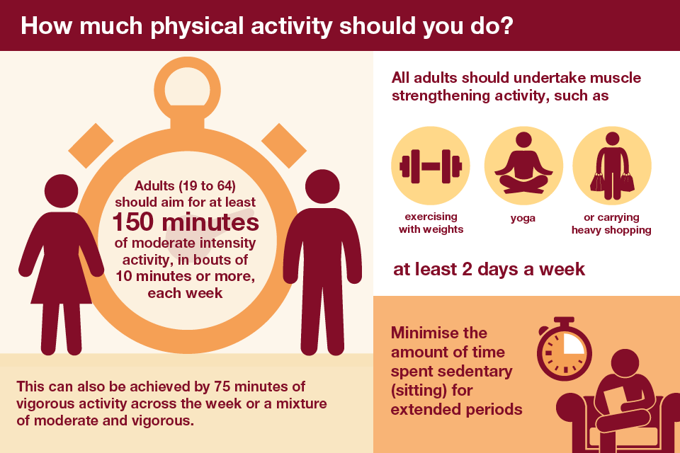
Notes:
Move More ( > 10,000 steps daily), Exert Yourself (30-60 minutes of moderate activity daily), Preserve Muscle Mass with Strength Training > 2 times/week
Strong Association btwn physical activity and postmenopausal breast (20-40%), colorectal (20%) and endometrial (20-30%) CA
DM, CVD, Falls, Depression, Joint/Back Pain
Improve sleep, maintain healthy weight, manage stress, improve quality of life
Can elicit biological changes – telomere lengthening, reduce inflammation, Repair DNA damage
Moderate – 150 min/week - feels somewhat hard, breathing quickens but you are not out of breath, sweating w/in 10 minutes, conversant but can't sing,
Vigorous – 75 min/week - feels very hard, breathing is deep and rapid, sweating w/in a few minutes, say a few words then out of breath

Slide 22
Notes:
More info re: cancer risk reduction

Slide 23
Additional Resources
American Institute of Cancer Research: www.aicr.org
Center for Disease Control and Prevention: www.cdc.gov
National Cancer Institute: www.cancer.gov
American Cancer Society: www.cancer.org
Oncology Nutrition, a dietetic practice group of the Academy of Nutrition and Dietetics: www.oncologynutrition.org
Mayoclinic: www.mayoclinic.com
The Cancer Project: www.cancerproject.org
USDA: www.usda.gov
Notes:
May end here

