Slide 1
Sarcoma History
What We Have Learned
Sarcoma Alliance - Sarcoma Exchange – October 2020
Fritz C. Eilber, M.D.
Director UCLA – JCCC Sarcoma Program
Professor of Surgery
Professor of Molecular & Medical Pharmacology
UCLA Division of Surgical Oncology

Slide 2
Disclosure
Certis Oncology – Scientific Advisory Board

Slide 3
What We Have Learned
Surgical
  Morbid → Less Morbid
Clinical Behavior
  Recurrence and Survival Dependent on Many Factors
Pathologic Diversity
Importance of Multidisciplinary Sarcoma Program
Importance of Clinical Trials

Slide 4
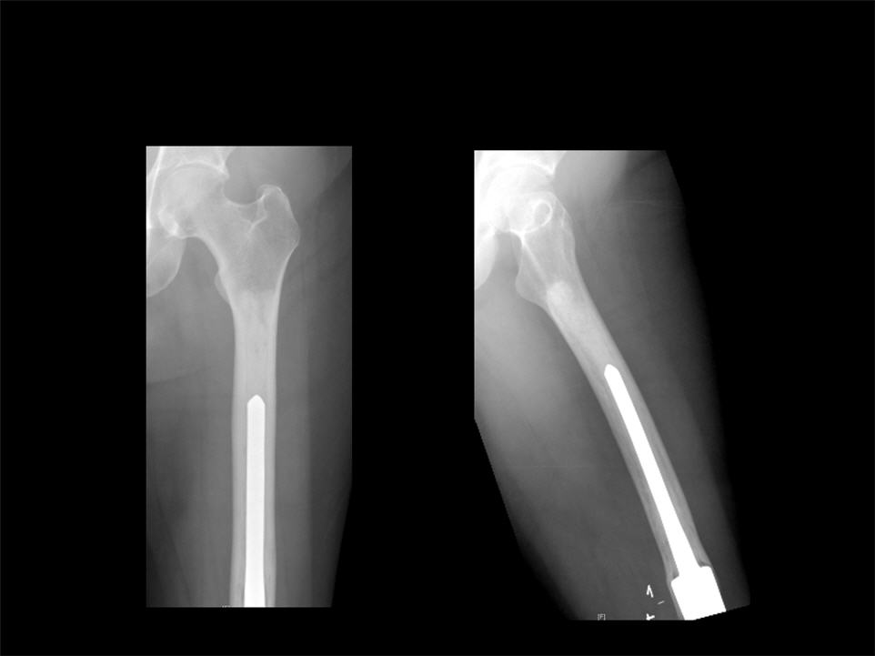
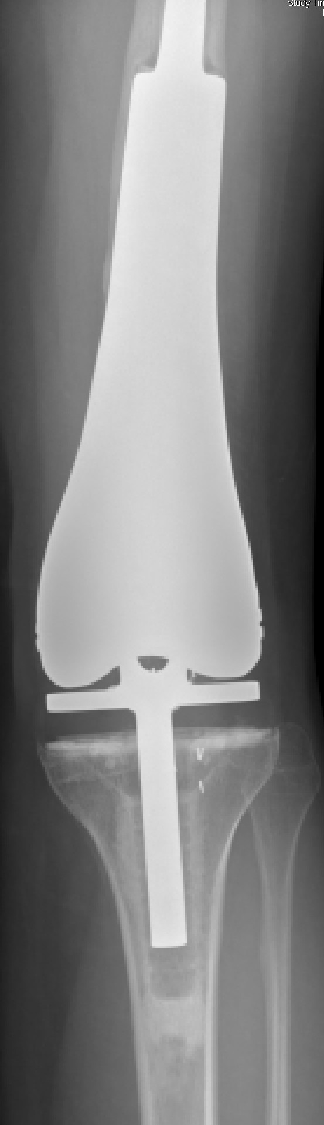
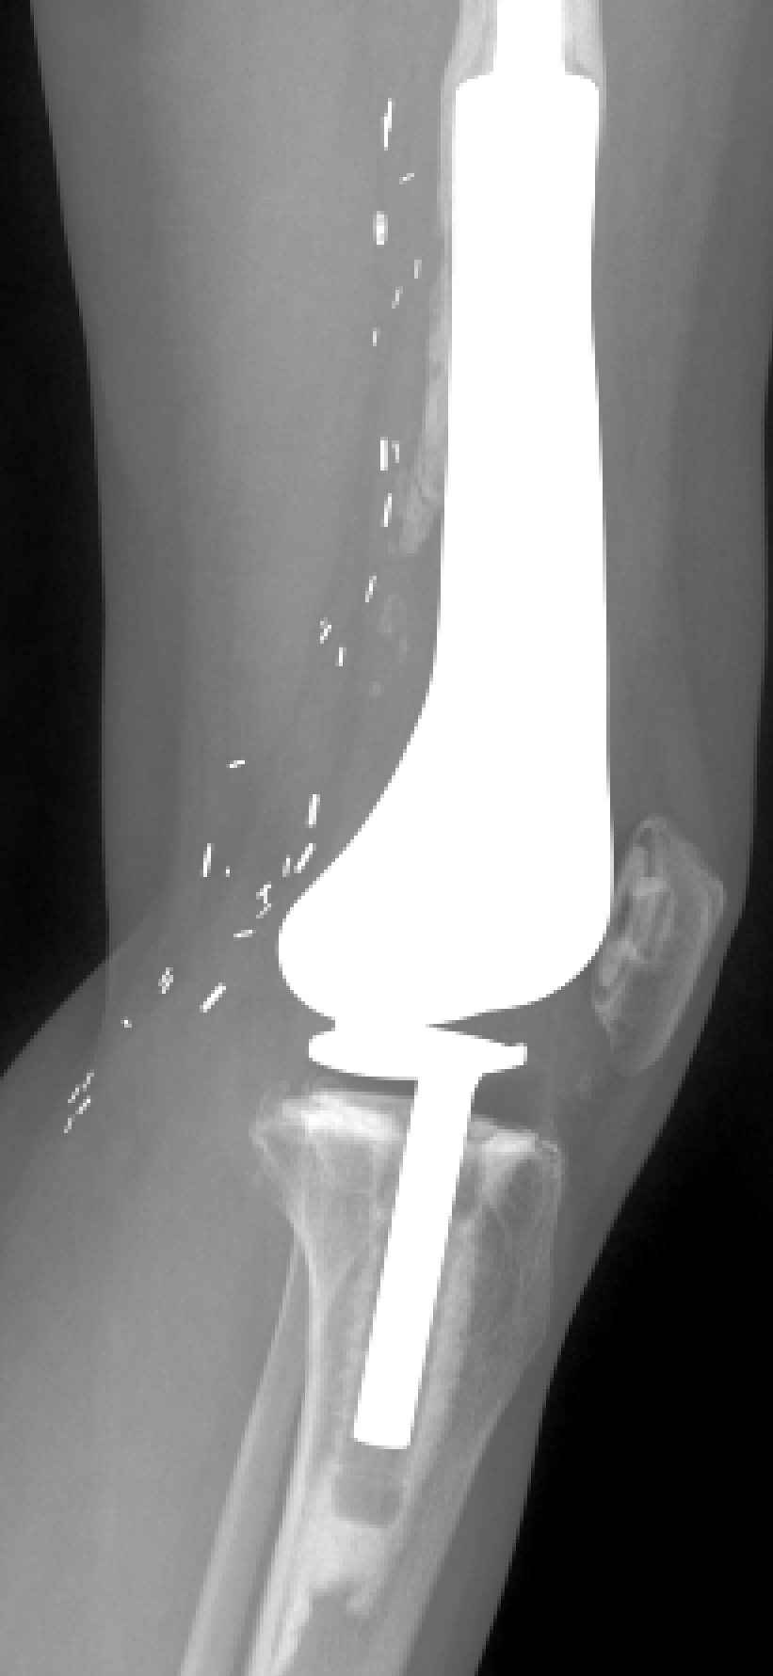
Surgery

Slide 5
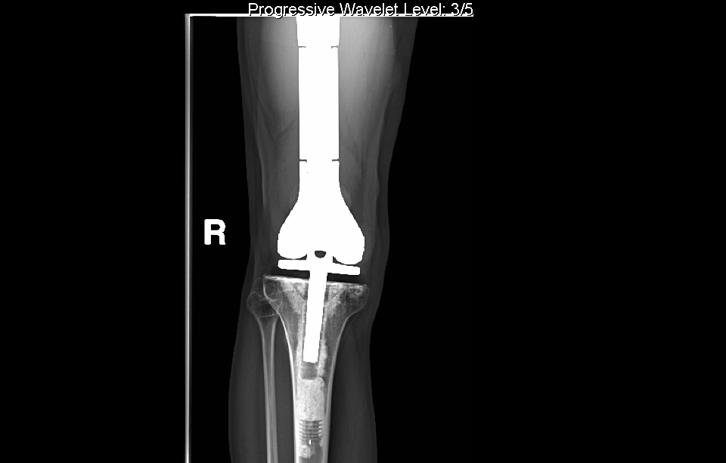
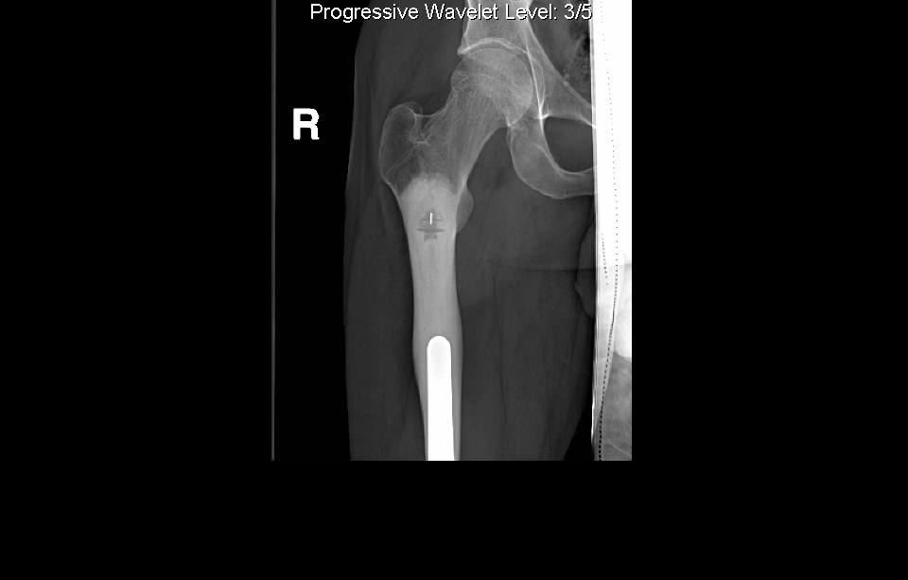
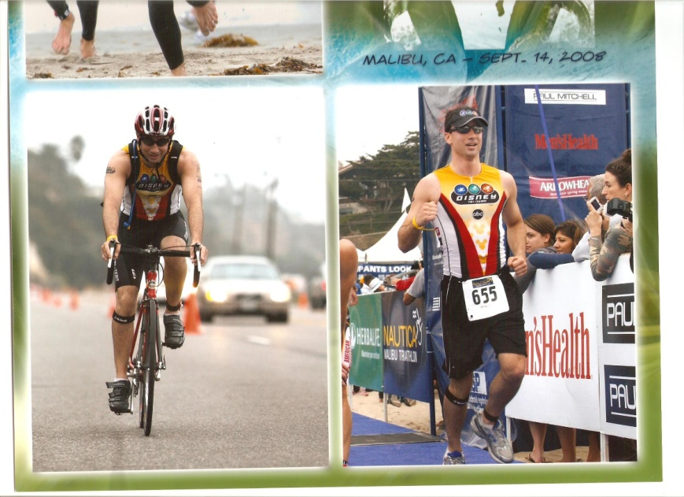


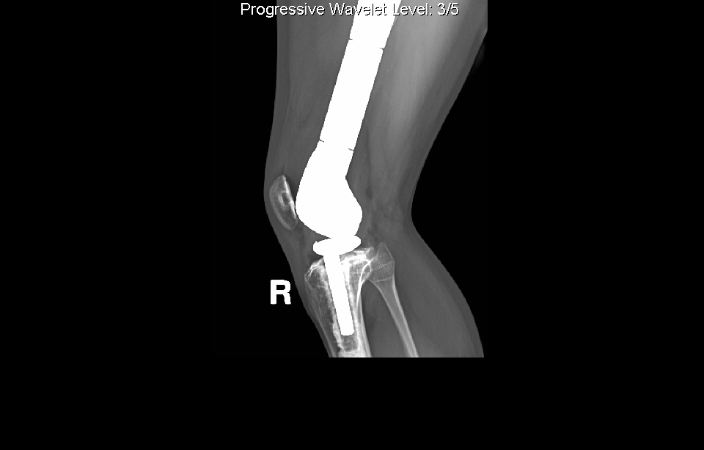
Surgery

Slide 6
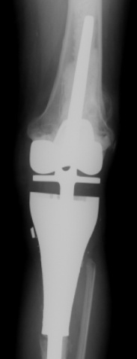

Surgery

Slide 7
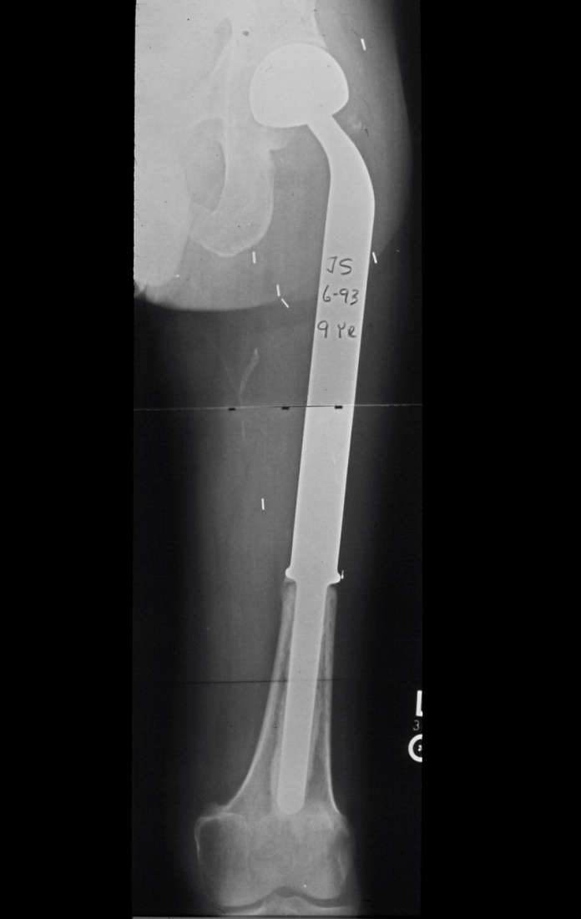
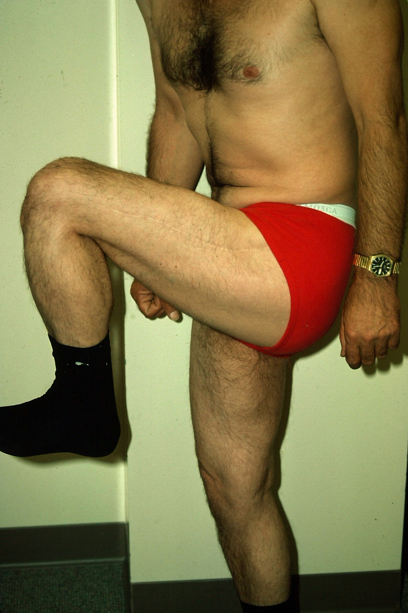
Surgery

Slide 8
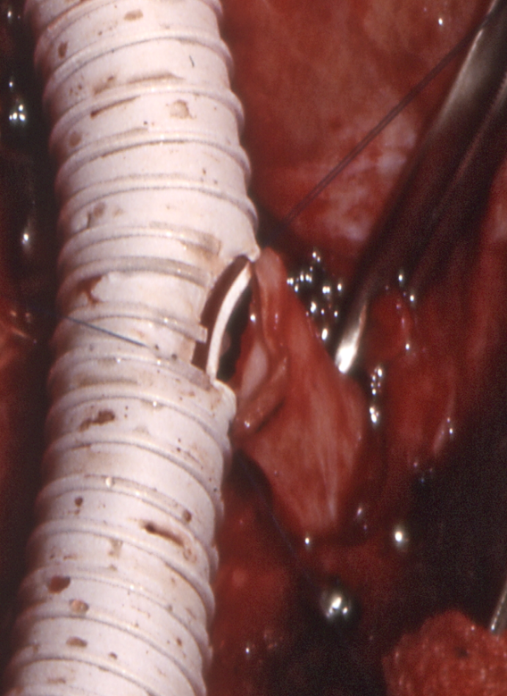
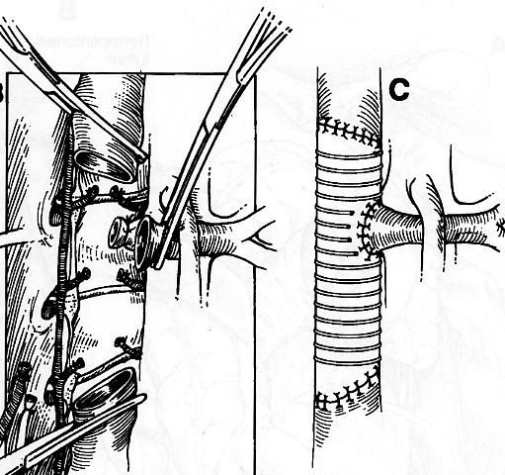
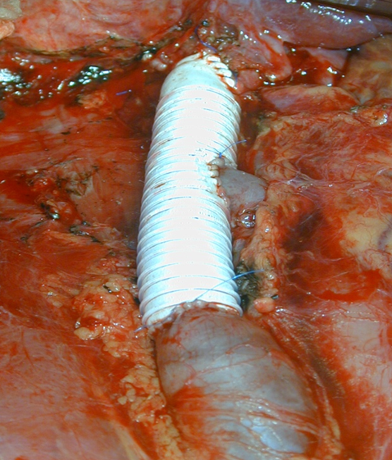
Surgery
Ringed PTFE Graft
Smaller than IVC to maintain higher flow velocities (12-14 mm)
Maintain rings at anastomoses

Slide 9
Clinical Behavior
Soft Tissue Sarcoma
Disease Specific Survival by Site
Brennan MF et al. Ann Surg. 2014 Sep;260(3):416-21

Slide 10
Clinical Behavior
Primary Extremity Soft Tissue Sarcoma
Disease Specific Survival by Grade
Brennan MF et al. Ann Surg. 2014 Sep;260(3):416-21

Slide 11
Clinical Behavior
Primary High Grade Extremity Soft Tissue Sarcoma
Disease Specific Survival by Size
Brennan MF et al. Ann Surg. 2014 Sep;260(3):416-21

Slide 12
MSKCC Postoperative Nomogram for 12-year Sarcoma-specific Death
Kattan MW et al. J Clin Oncol 20:791-796, 2002

Slide 13
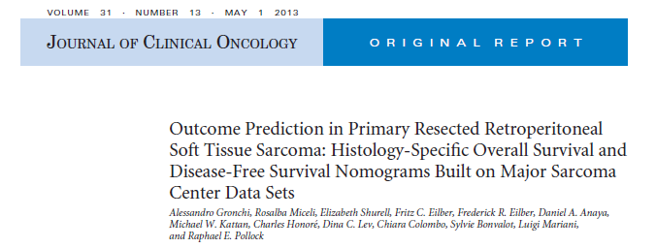
Retroperitoneal STS Nomogram

Slide 14
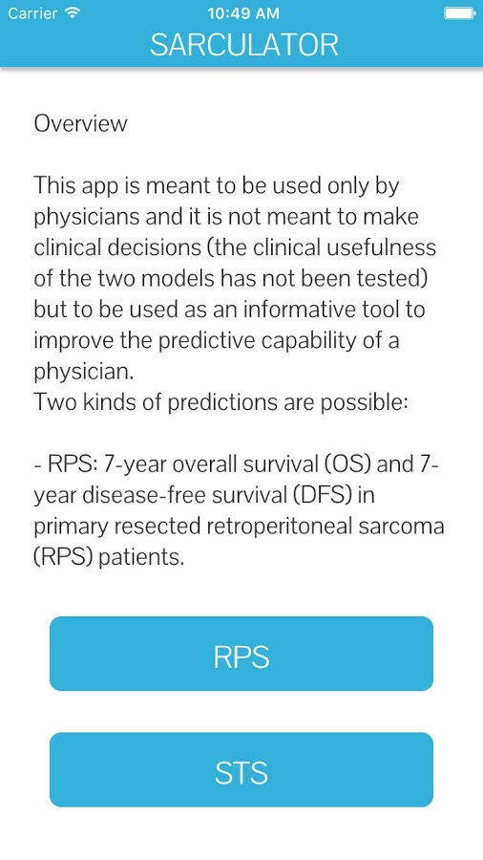

Sarculator – Sarcoma Calculator

Slide 15
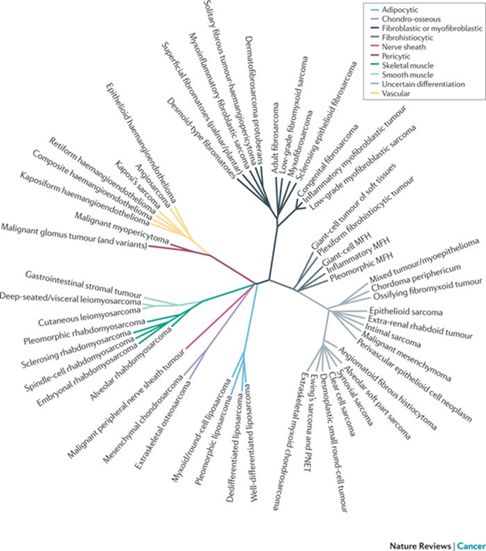
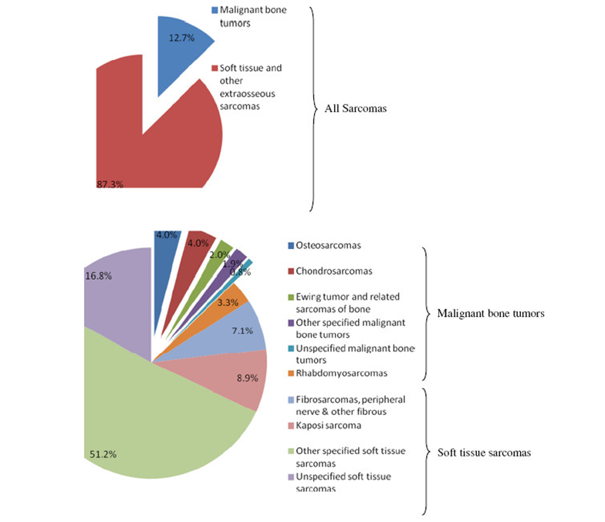
Pathologic Deversity
Rare & Pathologically Diverse Malignancies

Slide 16
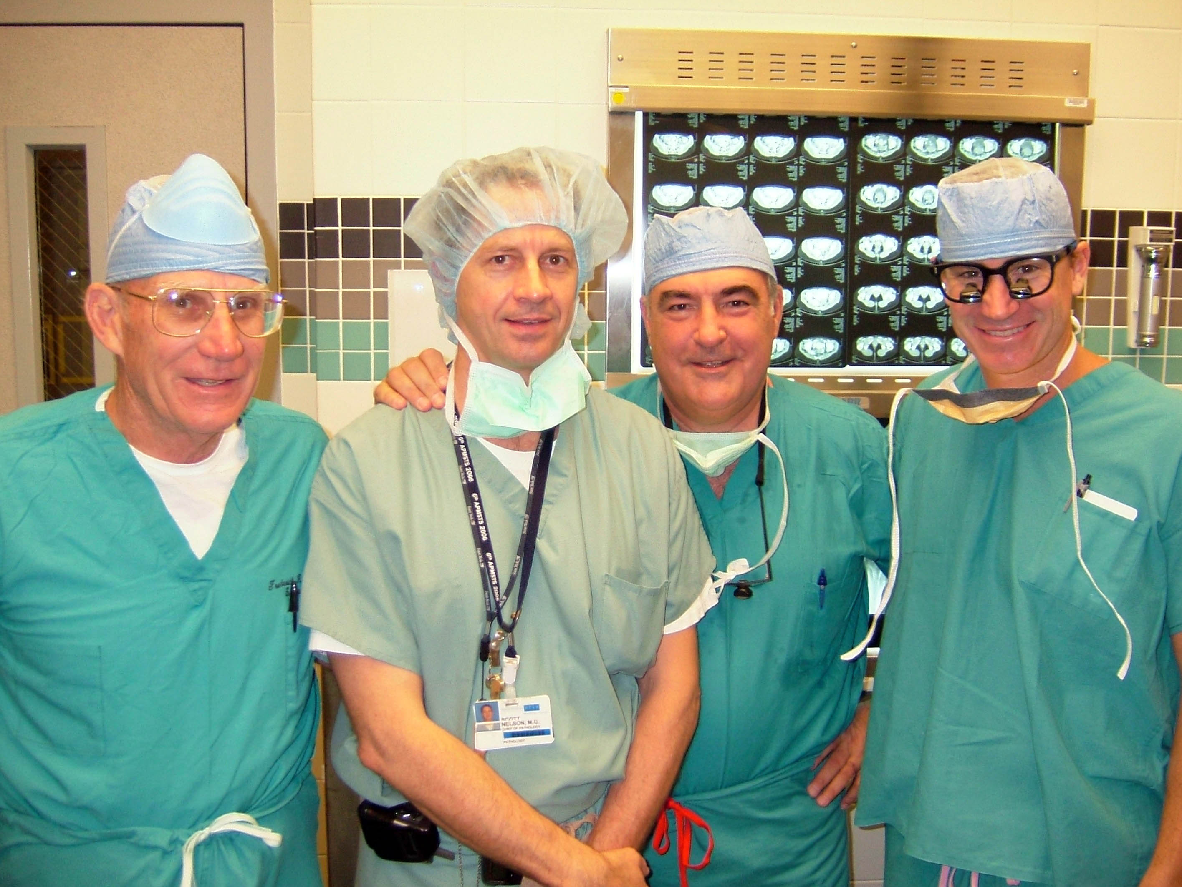
Sarcoma Specific Pathology & Surgery

Slide 17
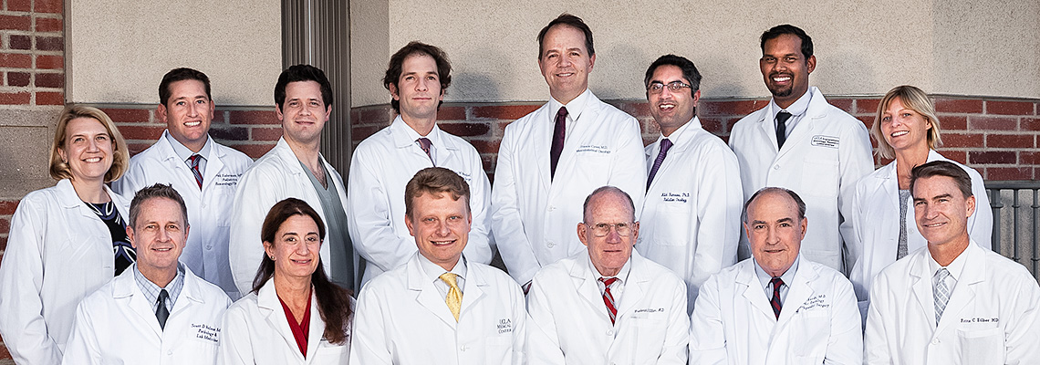
Sarcoma Multidisciplinary Care
UCLA Sarcoma Program

Slide 18
Thoracic Surgery
Surgical Oncology
Pediatric Oncology
Lee
Yanagawa
Orthopedic Oncology
Eilber Kadera Crompton
Federman
Medical Oncology
Bernthal Bukata Hornicek
Chmielowski Singh
UCLA Sarcoma Program
UCLA
Radiation Oncology
Pathology
Kalbasi
Nelson
Dry
GynOnc
Radiology
Nurse Coordinator
Cohen
Seeger Motamedi Levine
Brackert

Slide 19
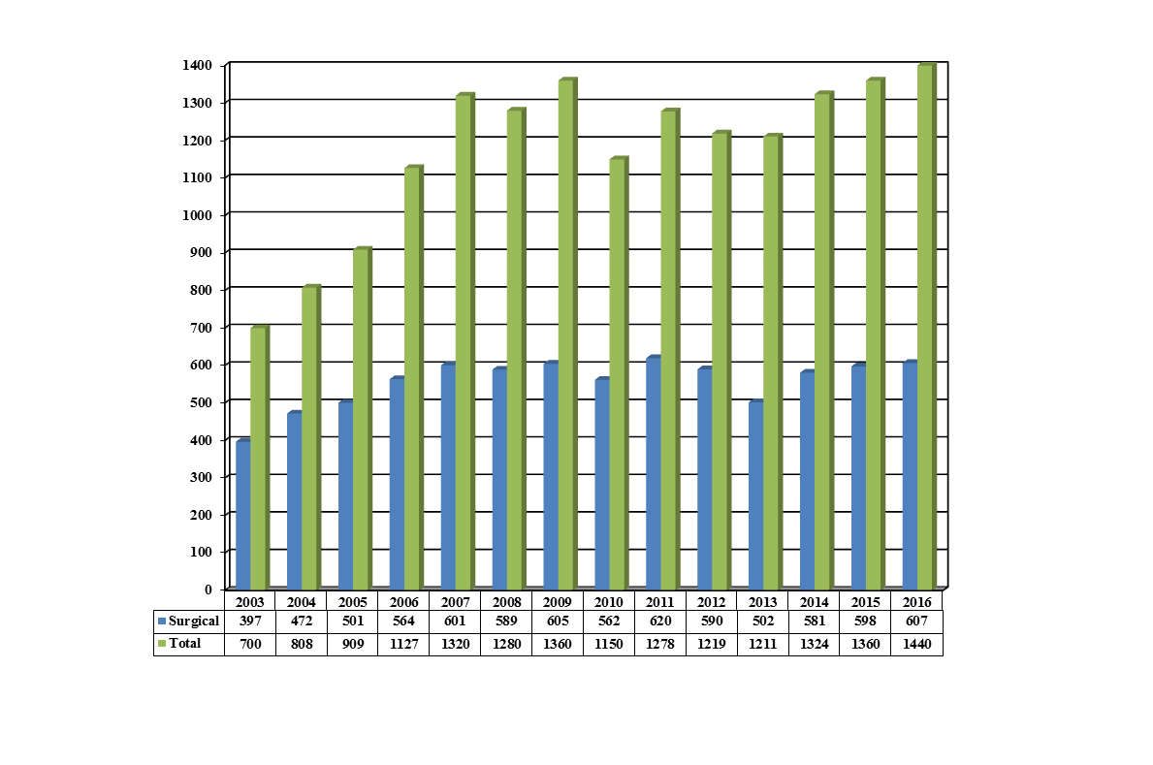
UCLA Sarcoma Program Annual Volume

Slide 20
Novel Approaches to the Management of Soft Tissue Sarcoma
Clinical Trials
Fritz Eilber MD – Surgical Oncology
  Introduction – Why Novel Approaches Needed
Arun Singh MD – Medical Oncology
  Adoptive Cellular Immunotherapy → Synovial Sarcoma
Anusha Kalbasi MD – Radiation Oncology
  Hypofractionated Pre-Op Radiation Therapy
    5 weeks → 5 days
Tara Russell MD MPH & Irmina Elliott MD
  Patient-Derived Orthotopic Xenografts (PDOX)
    Personalized Oncology

Slide 23
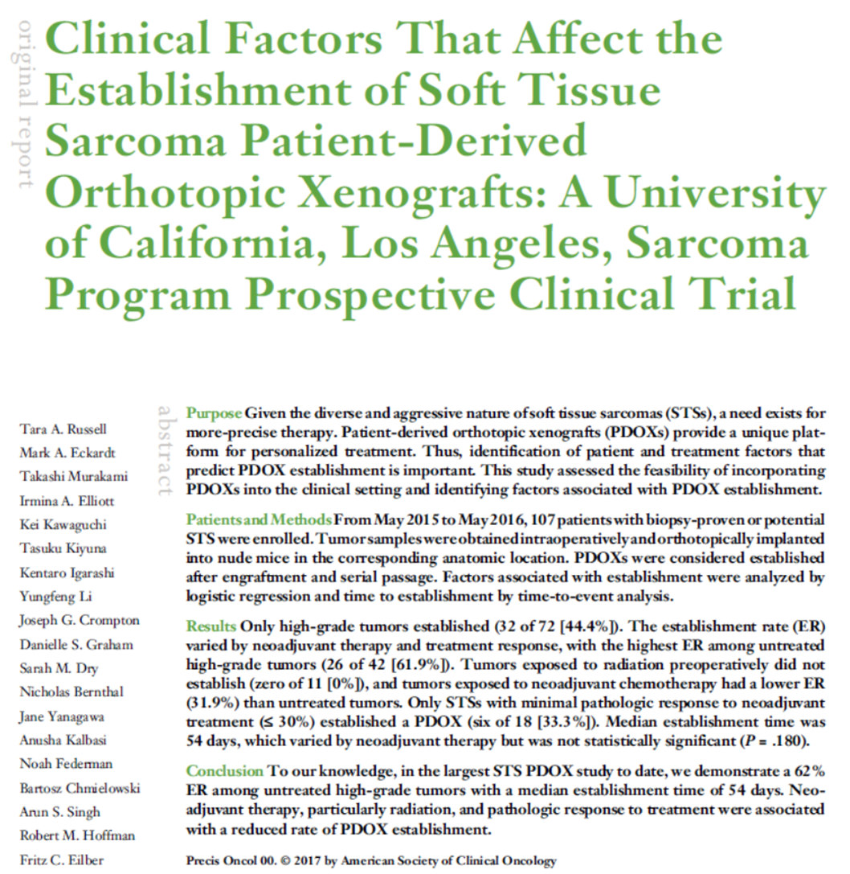

Slide 24
What We Have Learned
Surgical
  Morbid → Less Morbid
Clinical Behavior
  Recurrence and Survival Dependent on Many Factors
Pathologic Diversity
Importance of Multidisciplinary Sarcoma Program
Importance of Clinical Trials

