Slide 1
Core Principles in
CSC Support Groups
Uniting The Wellness Community and Gilda’s Club Worldwide

Slide 2
What Makes CSC Support Groups Unique?
Group Facilitation Model
Philosophy & methodology
Professionally-facilitated
Clinical supervision
Members are the experts
Value of Collective Wisdom
Variety of group experiences offered
Weekly heterogeneous groups
Networking groups
Time and open ended groups
Expertise and experience
Over 19,000 sessions in 2018 (includes children)
CancerSupportCommunity.org

Slide 3
What Makes CSC Support Groups Unique? (continued)
Proven outcomes:
CSC support group members report:
Improved partnership with health care team
Making lifestyle changes important to them
Developing a new attitude toward the illness
Improved ability to access information and vital resources
CancerSupportCommunity.org

Slide 4
What Happens in a
CSC Support Group?
Empowerment Topics:
Access to resources for coping with cancer
Learning about cancer, its treatment or side effects
Communication with health care team
Treatment decision-making and problem-solving
Advice-giving and –receiving among participants
Sharing one’s accomplishments and milestones
Exploring life issues beyond cancer
CancerSupportCommunity.org

Slide 5
Skills of a CSC Group Facilitator
Licensed mental health professional
Flexibility and sophisticated clinical skills
Members may be the ‘experts’ in cancer experience; facilitator is ‘expert’ in group dynamics
Avoid techniques/rules of group therapy
Check impulses to solve problems
Eliminate professional jargon or other signs of ‘authority’
Know personal boundaries
CancerSupportCommunity.org

Slide 6
The Role of the Facilitator
Keep the focus on the purpose of the group
Make sure everyone who wants to speak gets a chance
Connecting the dots
Modeling group norms
Asking “curiosity” questions
Giving feedback
Managing the exchange of advice
Use of one’s authentic self
CancerSupportCommunity.org

Slide 7
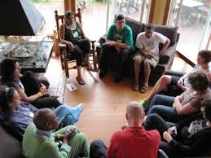
The Role of the Facilitator
A CSC group facilitator is:
Not an authority figure on
cancer or life
Not a ‘guru’
Not a problem-solver
Not a rescuer
Not a ‘converter’
CancerSupportCommunity.org

Slide 8
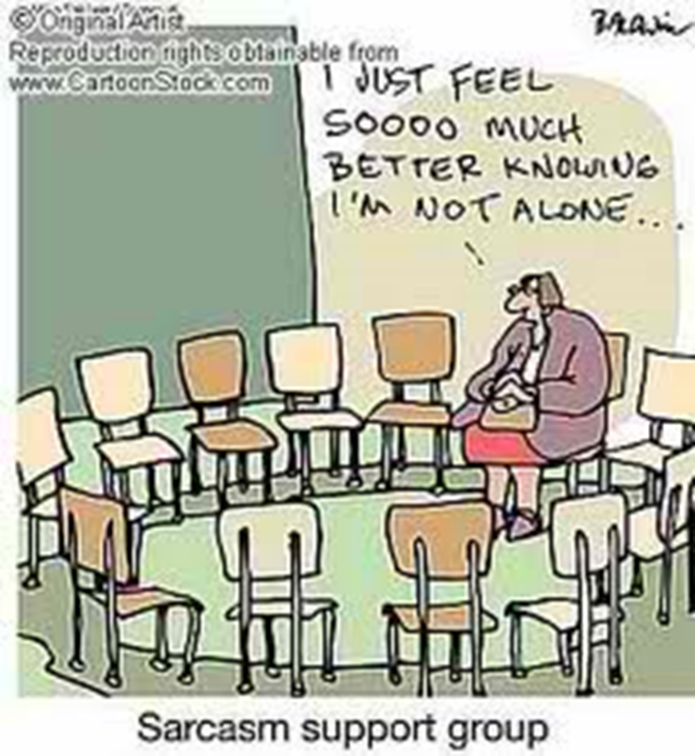
What Makes CSC Support Groups Unique?
CSC Group Facilitation:
The ideal facilitation style combines non-intrusive clinical skills with uncontrived personal disclosure and stimulates an environment in which members learn to facilitate mutual social and emotional support amongst themselves.
Joanna Bull – Founder Gilda’s Club
CancerSupportCommunity.org

Slide 9
Review of ground rules:
Confidentiality
Respecting individual opinions and point of views.
Respectful silence when someone is speaking and without interruptions and wait for your turn.
Please wait for introductions before asking questions of participants

Slide 10
Questions
CancerSupportCommunity.org

